Slide 1
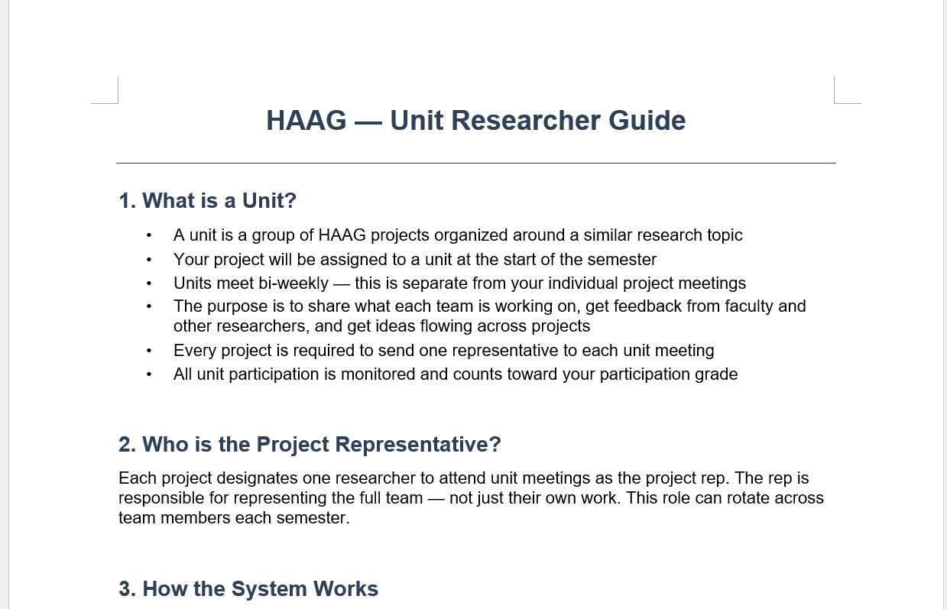

Unit Meeting and Collaboration
Researcher Introduction

Slide 2
What is Unit?
A group of HAAG projects organized around similar research topics, separate from your individual projects
Biweekly meetings for sharing ideas and feedback
Share ideas and progress amongst different research groups

Slide 3
Roles
Representatives
  One per project is mandatory
  Gets updates from non-participating members
  Make presentation and agenda out of everyone's updates
  Shares updates for the entire team
  Find alternative rep if they cannot make it to the meeting
Non-participating members​
  Submit an update template before meeting​
  Leave notes on template for reps​

Slide 4
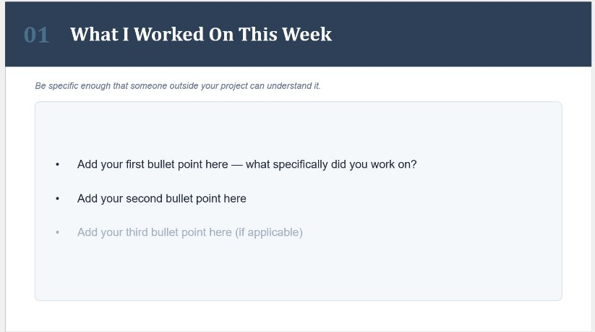
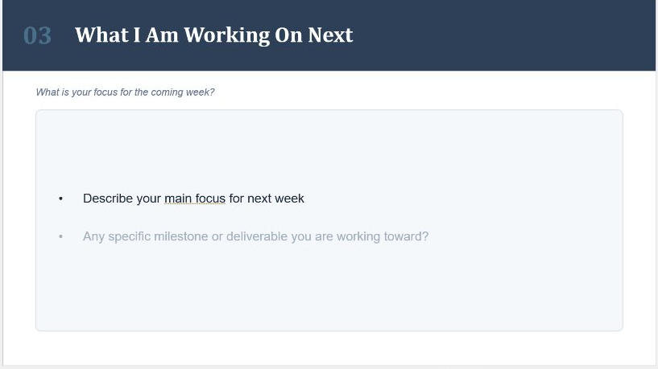
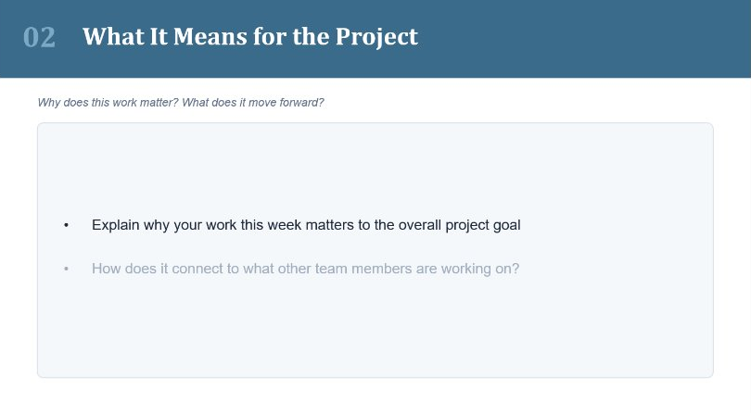
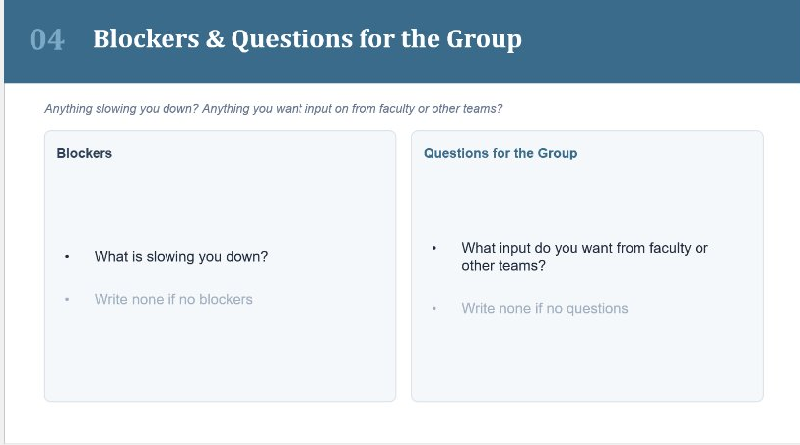
Update Templates
Includes the following:
  What was done this week
  What it means for the project
  What will be the next
  Blockers and questions
Full picture of the team
Reps will use this to build presentations and agenda

Slide 5
Unit Meeting
All recorded
Representatives present slides
  Share progress of their team
  Get feedback,
  Address any questions/concerns
  Share ideas with other researchers and faculty members
    Some groups may not have faculty member
If someone's work causes confusion, they must follow-up on the recording thread

Slide 6
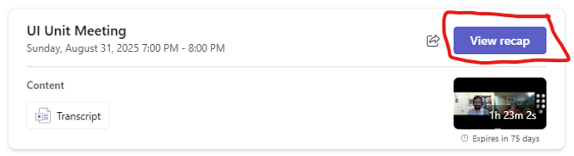
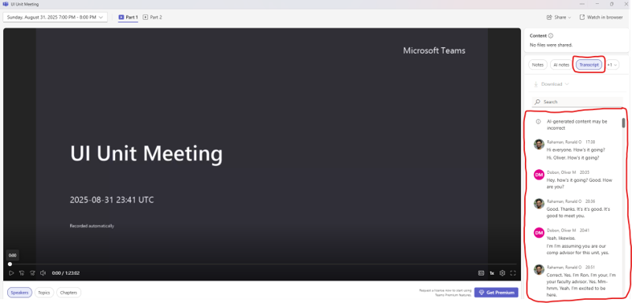
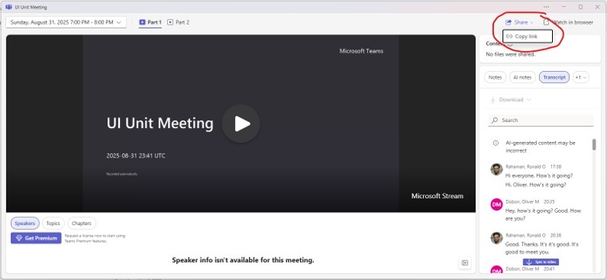
Post-Meeting
Reps will have to:
  Share a brief report with feedback and action items with the team
  Also post a recap to #time-log within 24 hours
    Grab recording, generate AI summary, and post the summary with a recording link and attendance list
LLM Summary

Slide 7
Working Sessions
Separate from unit meetings
Self-organized sessions that do not involve faculty
  Every project needs to attend with another team in their unit at least once per semester
  At least 3 people in attendance
Must report back on what they worked on afterwards

Slide 8
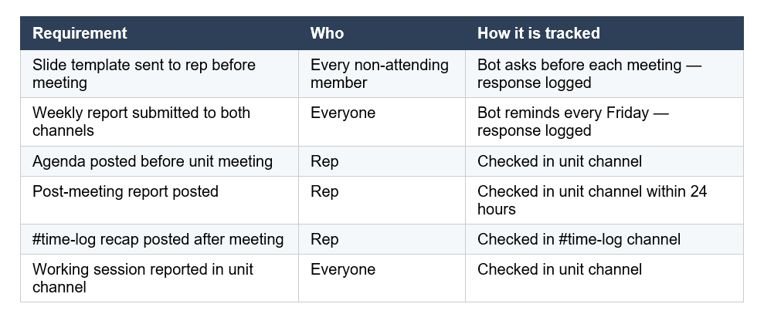
Grading
All the reports, templates, agendas, and attendance will be tracked for grading purposes

